Slide 1



Loan Application Status Prediction
This dataset includes details of applicants who have applied for loan. The dataset includes details like credit history, loan amount, their income, dependents etc.
by Yuva Karthikeswar Dadisetty
AI/ML Intern

Slide 2

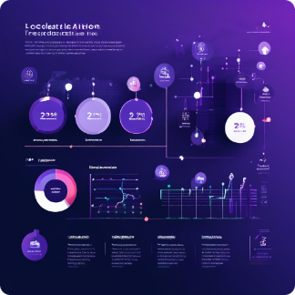
Independent Variables
1
Loan_ID
2
Gender
A unique identifier for each loan application.
The gender of the loan applicant.
3
Married
4
Dependents
Whether the applicant is married or not.
The number of dependents the applicant has.

Slide 3


Independent Variables (cont.)
1
Education
2
Self_Employed
The educational qualification of the applicant.
Whether the applicant is self-employed or not.
3
ApplicantIncome
4
CoapplicantIncome
The monthly income of the applicant.
The monthly income of the co-applicant, if any.

Slide 4

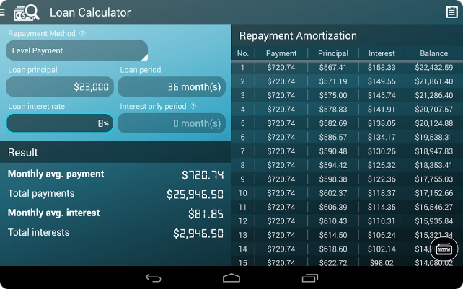
Independent Variables (cont.)
1
Loan_Amount
The loan amount requested by the applicant.
2
Loan_Amount_Term
The duration of the loan in months.
3
Credit_History
Whether the applicant has a good credit history or not.
4
Property_Area
The area where the applicant's property is located.

Slide 5

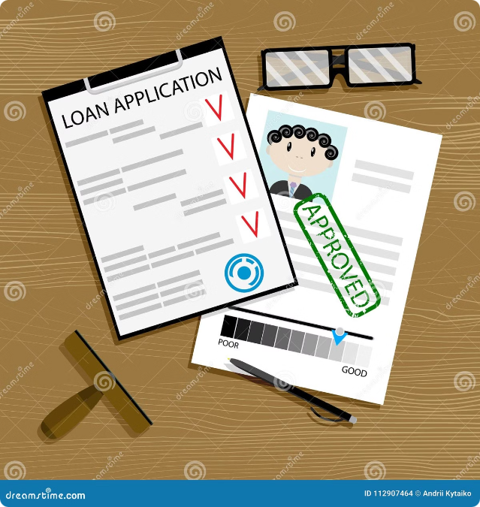
Dependent Variable
The dependent variable, also known as the target variable, is the variable that we are trying to predict. In this case, the dependent variable is Loan_Status, which indicates whether the loan of the applicant will be approved or not.

Slide 6


Predicting Loan Approval
The goal of this project is to build a model that can predict whether the loan of the applicant will be approved or not based on the details provided in the dataset. This model can be used by financial institutions to automate the loan approval process and make more informed decisions.

Slide 7
Data Cleaning & Pre-processing
Import Necessary Libraries
Read CSV file
Shape of the Dataset
Removing the Irrelevant Columns
Summary of the Dataset
Data types in the dataset
Checking Null Values
Filling Null Values
Checking Duplicated Values

Slide 8
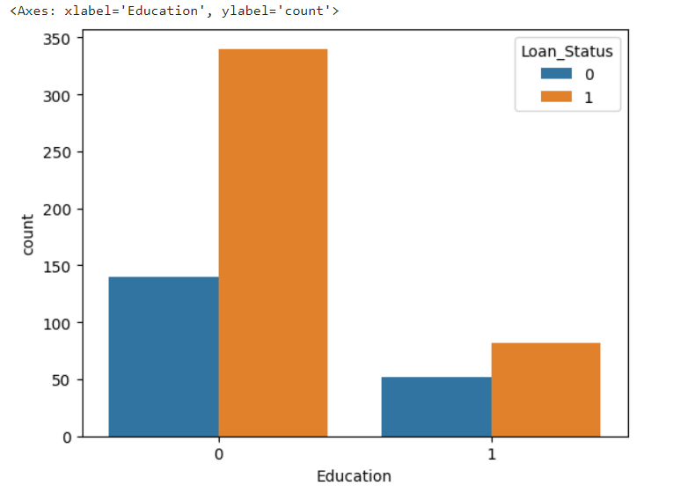
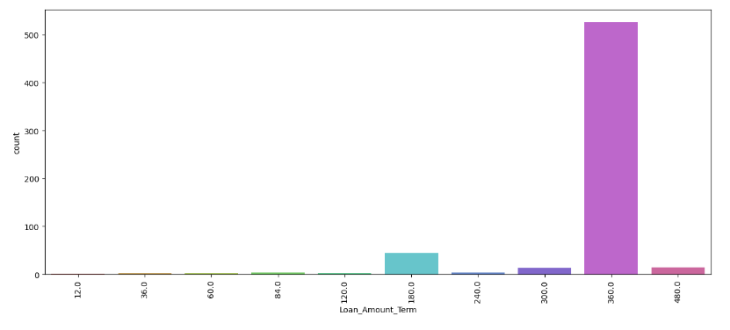
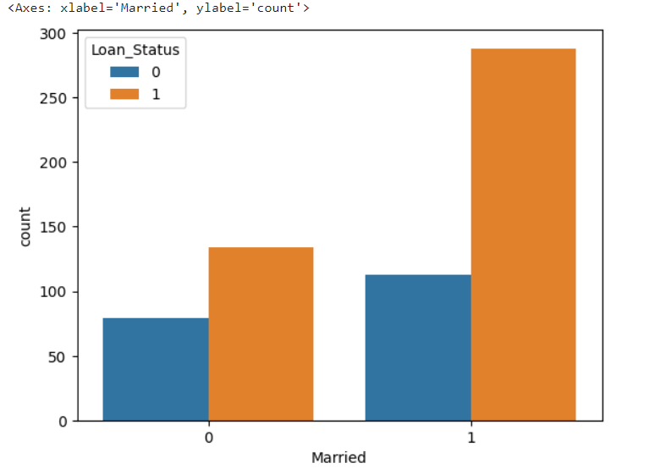
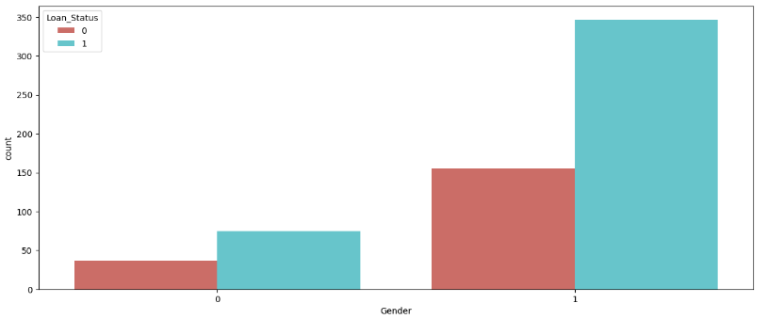
Data Visualization

Slide 9
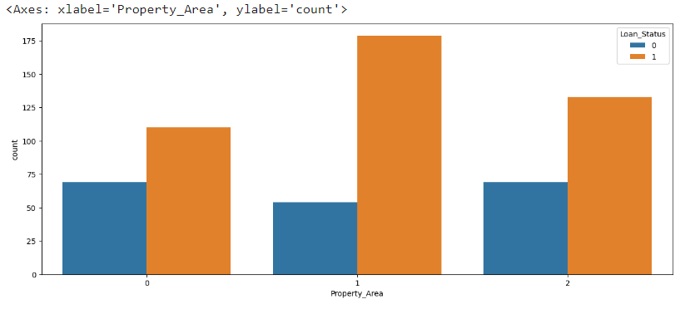
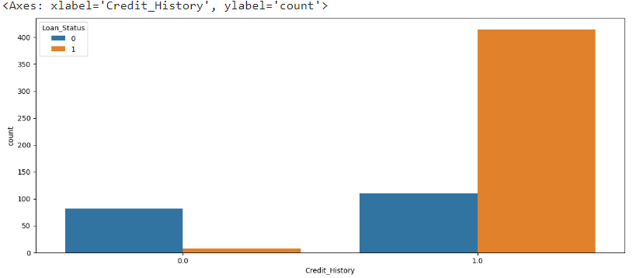
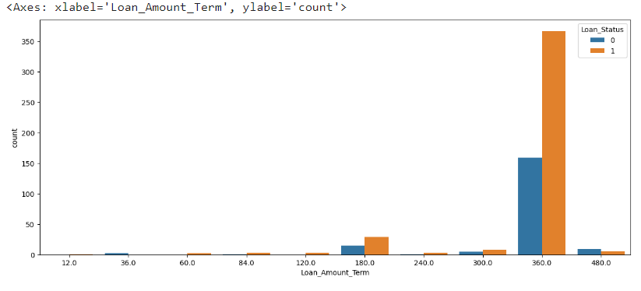
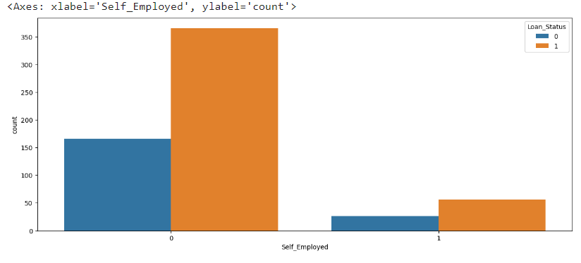
Data Visualization

Slide 10
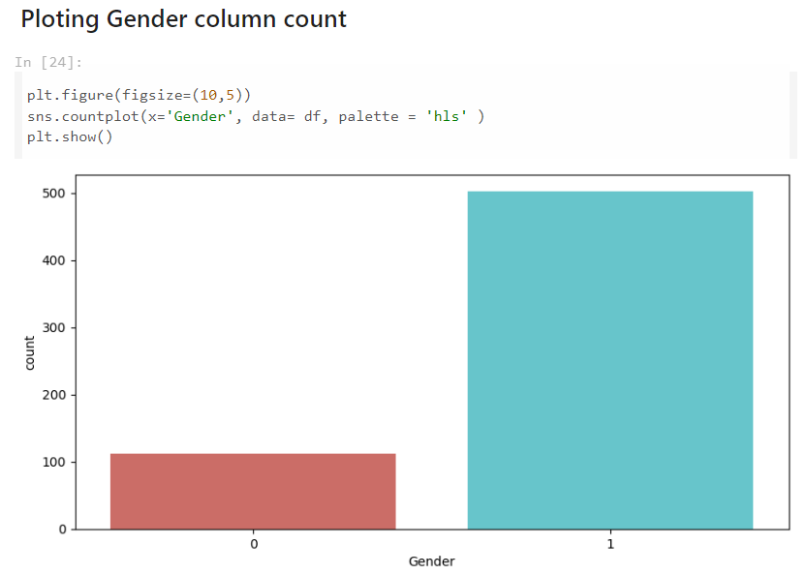
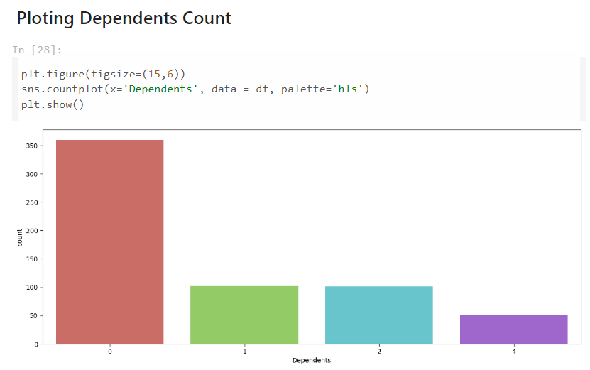
Exploratory Data Analysis (EDA)

Slide 11
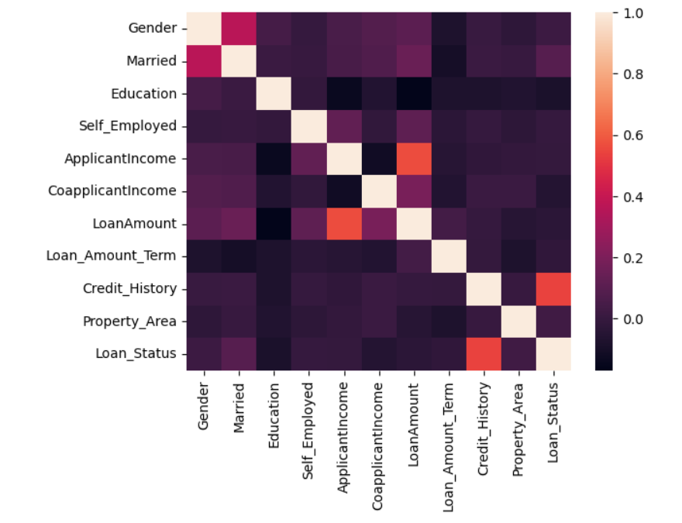
Correlation (Heat Map)

Slide 12

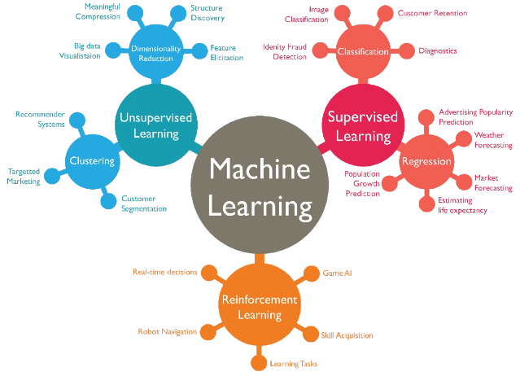
Model Building
To build a model that can predict loan approval, we will need to use machine learning algorithms. These algorithms can learn from the data and identify patterns that can be used to make predictions. Some common machine learning algorithms that can be used for this task include logistic regression, decision trees, and support vector machines.

Slide 13
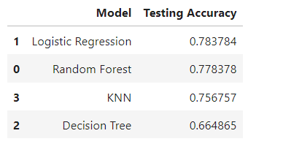
Model Evaluation
Once we have built a model, we need to evaluate its performance. This involves testing the model on a separate dataset that was not used to train the model. The evaluation metrics used will depend on the specific task like accuracy.
Results of All Models
We are presenting the results of all models that have been utilized to access the accuracy of this dataset. The results are showcased here.

Slide 14

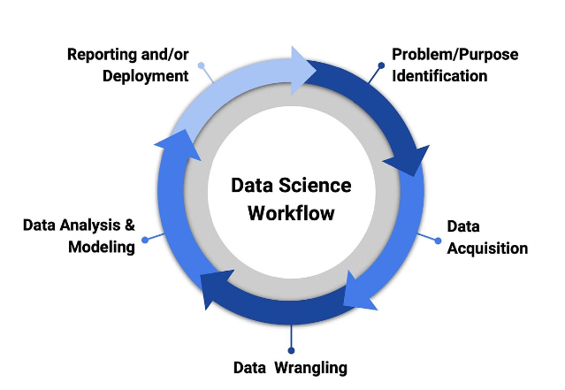
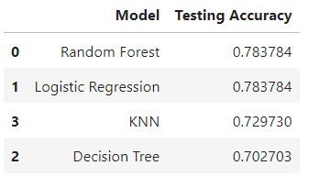
Model Optimization
After evaluation, the model may require optimization to improve its performance. This can involve adjusting hyper parameters, feature engineering, or trying different algorithms. The goal is to find the best model configuration that achieves the desired level of accuracy.
Results of Re-Trained Models
After evaluation, Displaying the results of the retrained models; these are presented here

Slide 15


Conclusion
By building a model that can predict loan approval, we can help financial institutions make more informed decisions and improve the efficiency of their loan approval process. This can benefit both the financial institutions and the loan applicants.

Slide 16
Thank You

